Slide 1
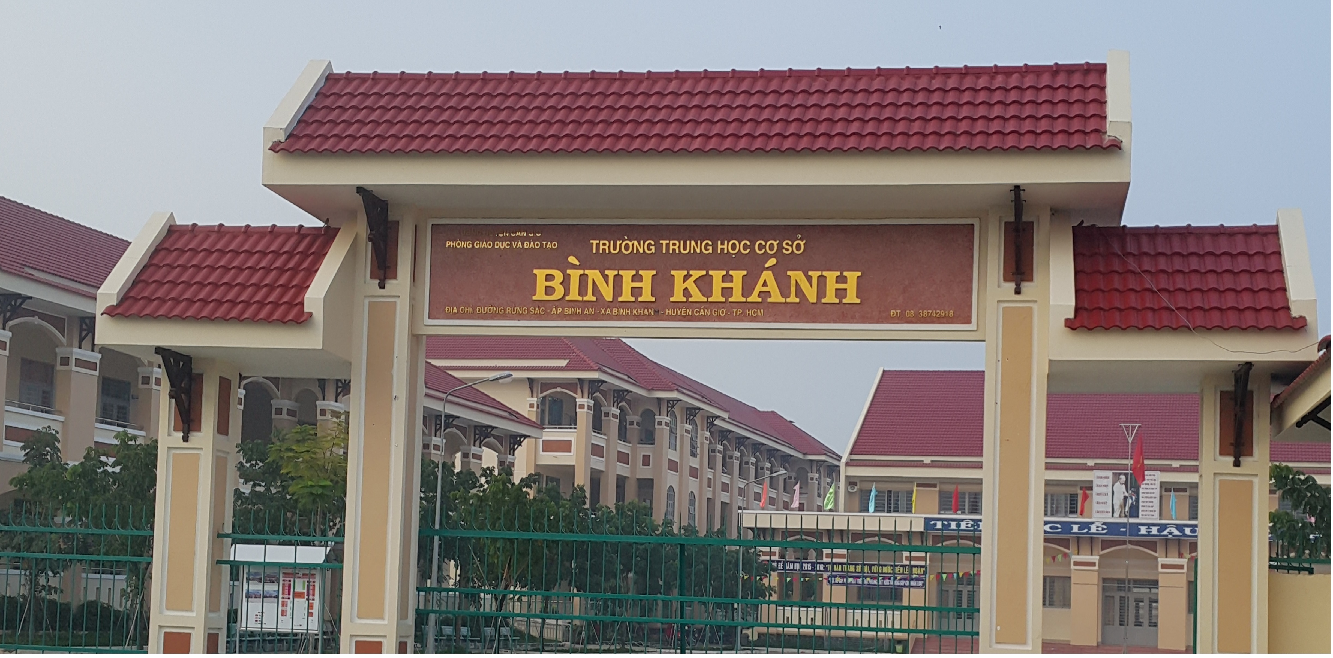
ENGLISH 9
BINH KHANH SECONDARY SCHOOL

Slide 2
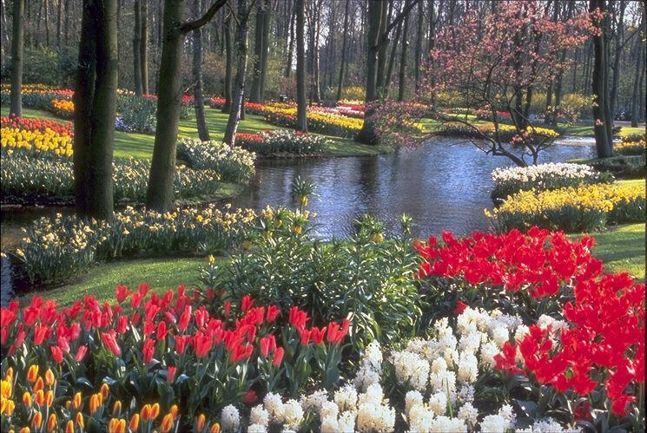
Unit 6. The environment. Period 39: Read

Slide 3
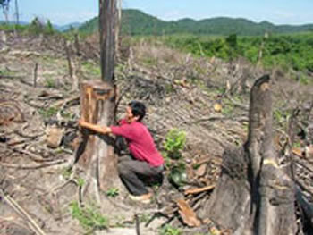
Where is the forest?

Slide 4
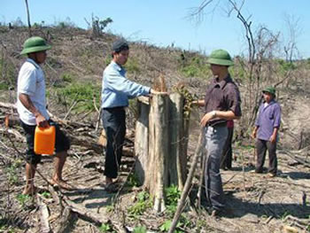
After cutting down the forest ……

Slide 5
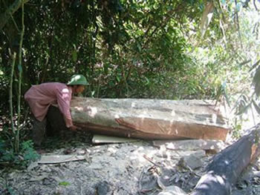
Do you want to help him? Why?

Slide 6
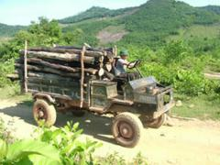
Where is the wood taken?

Slide 7
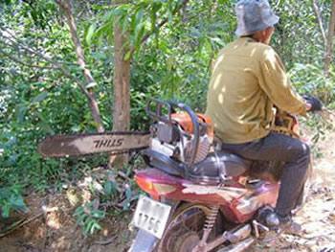
What is this man going to do? Can you stop him?

Slide 8
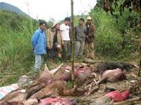
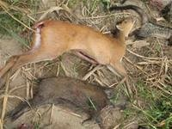
Have you ever said “No eating wild animals’ meat”?

Slide 9
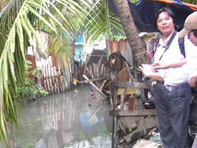
Do you want to live in this place?

Slide 10
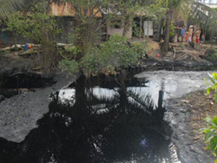
Who are responsible for the pollution?

Slide 11
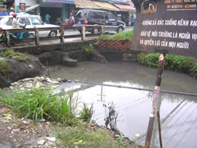
Do you notice this sign?

Slide 12
MUMMY,OH MUMMY
“ Mummy, oh Mummy, what’s going to happen
If all the pollution goes on?”.
“Well the world will end up like a second-hand junk-yard,
With all of its treasures quite gone.
The fields will be littered with plastics and tins,
The streams will be covered with foam.
Now throw those soda bottles over the hedge,
Save us from taking them home”
“ But Mummy, oh Mummy, if I throw the bottles,

Slide 13
Won’t that be polluting the woods?”
“Nonsense! That isn’t the same thing at all,
You just keep quiet and be good.
If you’re going to start getting silly ideas,
I’ll take you home right away.
Because pollution is something that other folk do,
We’re just enjoying our day”.

Slide 14
Work in corner
Corner 1: Practice reading the poem.
Corner 2: Match the words in A to an appropriate explanation.
Corner 3: Answer the questions(1,2,3,4,5)/page51. Then write the answers in your exercise book.
Corner 4: Watch a video clip. Then express your ideas about:
* Name some environmental problems?
* What will happen if the pollution goes on?
* How to minimize pollution?
* What you could do in your school/ house to minimize pollution?

Slide 15
a) Match each word in A …
1. Junk-yard : a piece of land full of rubbish.
2. End up : reach a state of.
3. Treasure : valuable or precious things.
4. Foam : mass of bubbles of air or gas.
5. Stream : a flow of water.
6. Hedge : a row of things forming a fence.
7. Folk : people.

Slide 16
b. Answer the questions/page 51
1. According to the mother, what will happen if the pollution goes on?
If the pollution goes on, the world will end up like a second hand junk yard.
2. Who does the mother think pollute the environment?
She thinks other folk pollute the environment but not her or her son.

Slide 17
3. What will happen to the boy if he keeps on asking his mother such questions?
His mother will take him home right away.
4. Do you think the boy’s question (line 9-10) is silly ? Why (not)?
No. Because he is right, If he throws the bottles that will be polluting the woods
5. What does the poet want us to learn about keeping the environment unpolluted?
The poet wants us to learn that everyone is responsible for keeping the environment from pollution.

Slide 18
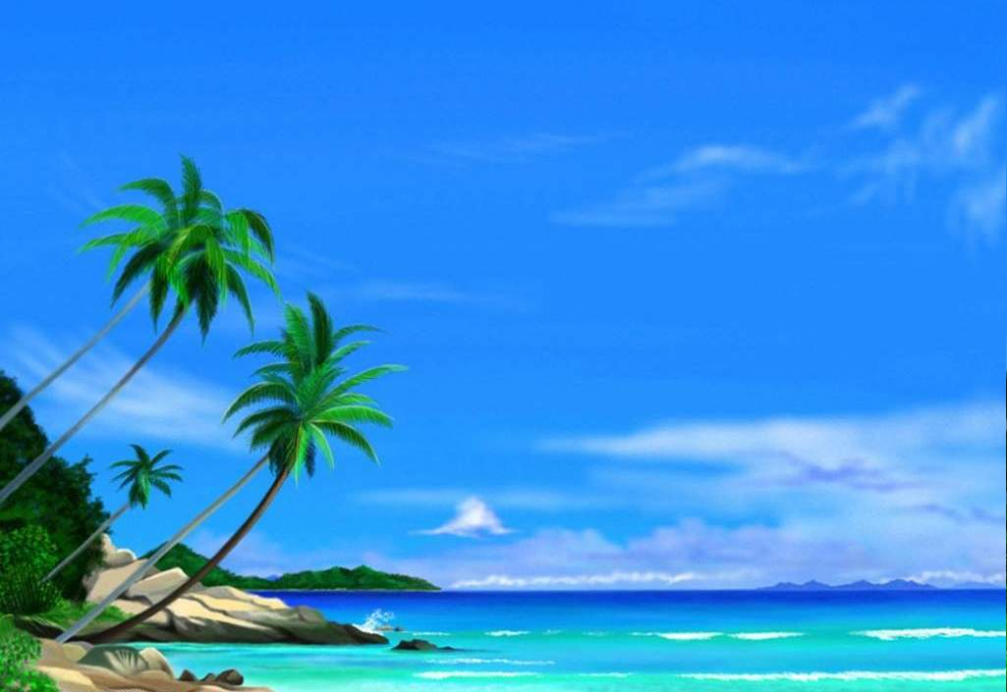
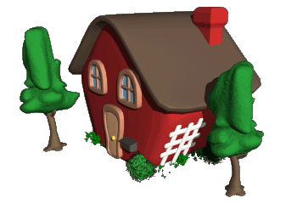
Homework
Write about what you have done and what you are going to do to minimize pollution.
Let's keep our environment unpolluted

